Slide 1
Revolutionizing Medrec solution for MEDREC: MedME
Patient/caregiver Working group
Rob Hausam Miranka Nicole
John Destefano Jason Cory Brunson
Sandra Czunas Pat Carroll
Dong-guk shin Rick Munger

Slide 2
Problem Statement (PATIENT)
Not having a current list of medications the patient is taking
Lack of understanding why they are taking a particular medication
Truth is always changing
No easy way to communicate questions/concerns in a timely manner
side-effects,
duplicates,
etc
Vulnerable populations: elderly patients, cognitive impairment, behavioral health issues; those who require caregivers

Slide 3
Problem statement (HEALTH PROFESSIONALS)
Other health care professionals involved in care cannot link medications to diagnosis
Data needs to be pulled from multiple providers and sources
Limited information on over the counter drug, supplements, herbals that patients are taking
Prescriber does not have easy access to formulary or cost

Slide 4
Features
Summary medication list (electronic +printable)
Link medications to diagnoses
Prescribing provider and specialty for each medication
Allergies

Slide 5
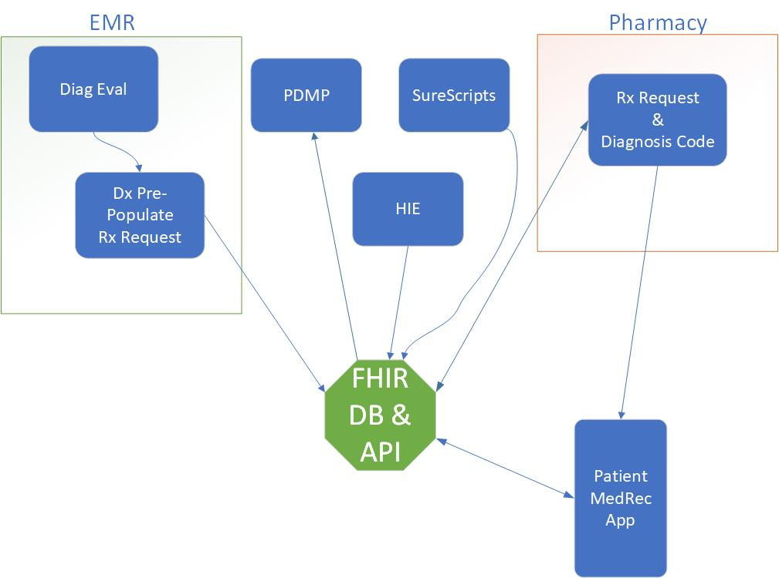
Proposed solution

Slide 6
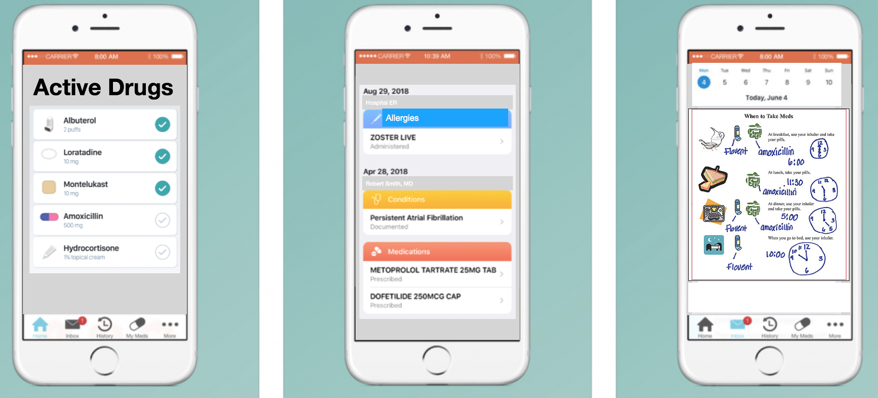
User interface

Slide 7
Patient summary

Slide 8
Data flow

Slide 9
User Flow

Slide 10
Med rec (ACTIONS by patients)
Compare the pill bottles in the home to the list provided and confirmed by physician
Tell the prescriber if the patient is not taking a particular medication

Slide 11
MED rec (actions by health professionals)
Identify medications that could interact
Identify inappropriate or high risk prescribing

Slide 12
Usability principles
Use users language
Match system and world
Users in control

